Slide 1
HATR (Hierarchical Adaptive Temporal-Relational Modeling for Stock Trend Prediction)
2021
IJCAI
( Conference Rank: CCF A )
汇报人：张天璞

Slide 2
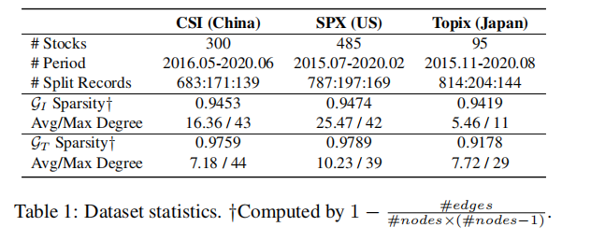
简介
数据集
股票趋势预测难点
目前方法都是基于每个股票都是相互独立的，或者是基于预先定义的图结构来进行股票趋势预测

Slide 3


Preliminaries
时空特征
图上节点特征

Slide 4
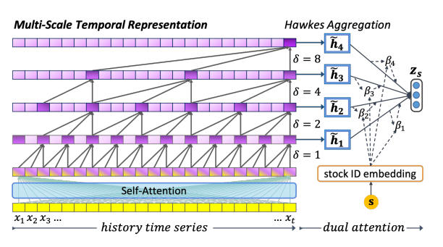
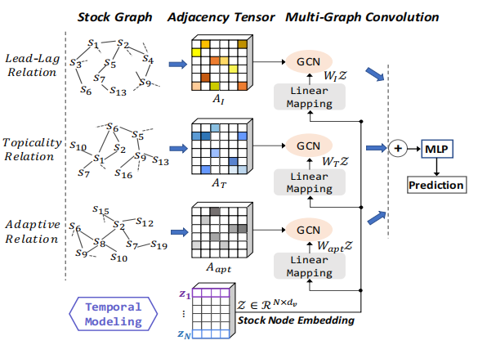
模型结构

Slide 5


模型结构
Multi-Scale Temporal Representation
Encoding layers

Slide 6



模型结构
Multi-Scale Temporal Representation
Time and Scale-wise Dual Attention
^{[1]}
[1] Emmanuel Bacry, Iacopo Mastromatteo, and Jean-Franc¸ois Muzy. Hawkes processes in finance. Market Microstructure and Liquidity, 1(01):1550005, 2015.
Notes:
历史波动模式对股票的未来演化有不同的相关性。研究表明，在股市中，事件流的影响会随着时间的推移而减弱

Slide 7





模型结构
Multi-Scale Temporal Representation
Time and Scale-wise Dual Attention

Slide 8


模型结构
Stock Interrelation Modeling
Graph Construction of Various Relations
Industry Graph
Topicality Graph
两个股票的相关话题数量加权^{[2]}
Self-Adaptive Graph
[2] Heyuan Wang, Tengjiao Wang, and Yi Li. Incorporating expert-based investment opinion signals in stock prediction: A deep learning framework. In AAAI, pages 971–978, 2020.

Slide 9




模型结构
Stock Interrelation Modeling
Diffusion Graph Convolution

Slide 10

模型结构
Prediction Layer

Slide 11
创新点
在扩散卷积中添加了attention机制使得不同时刻具有不同权重

Slide 12
END
Thank you

